Slide 1
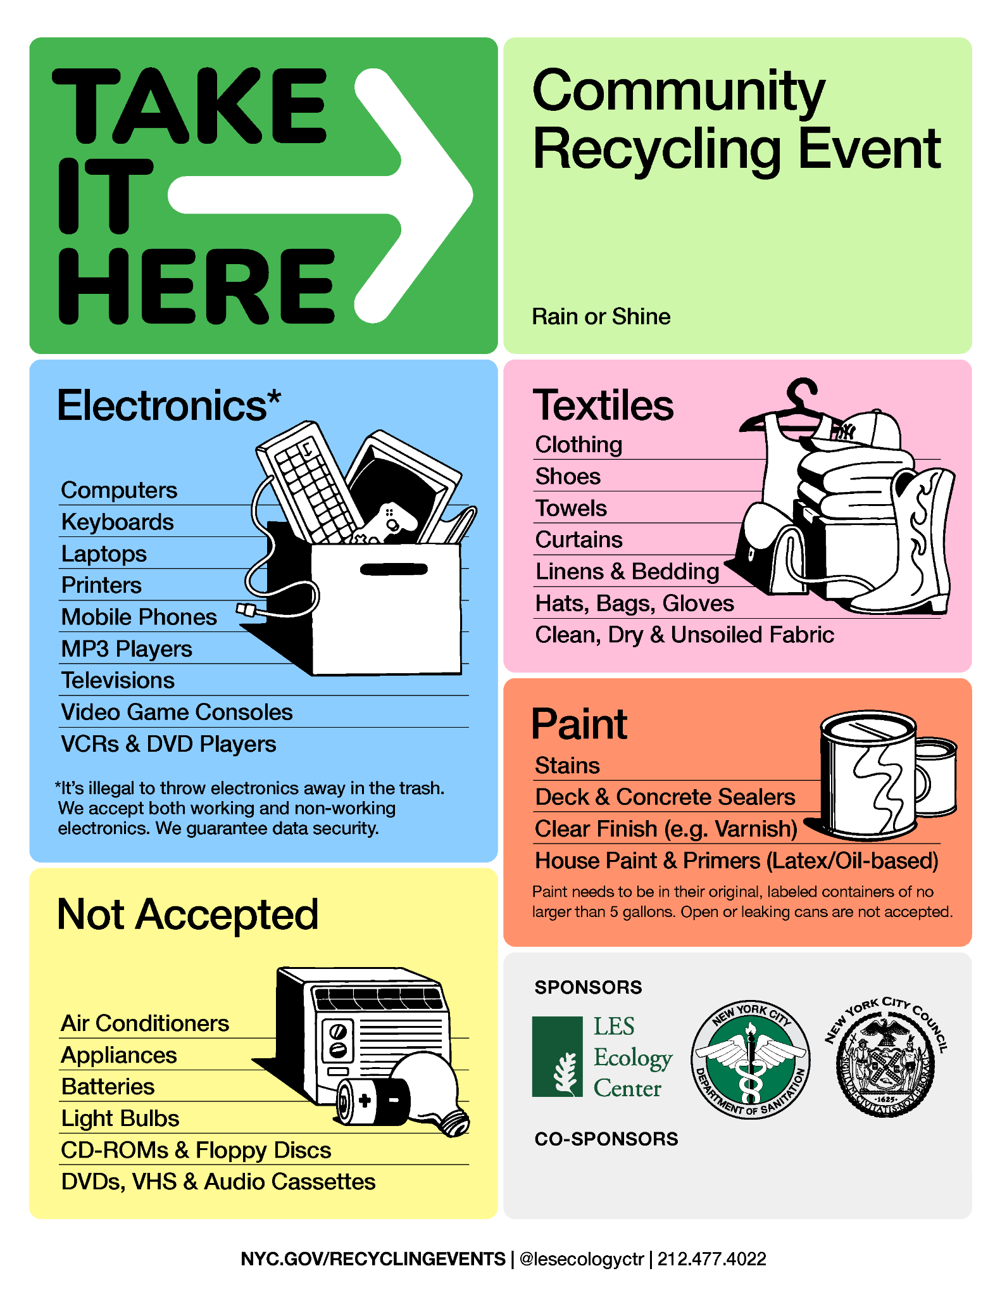
Sunday 07/12/26 • 10am – 2pm
Union Square Park, North Plaza cars enter safety zone @ Park Ave S & E 17th Street
Council Member Harvey Epstein, Assemblymember Keith Powers, and Senator Brian Kavanagh
In partnership with PaintCare

